Slide 1


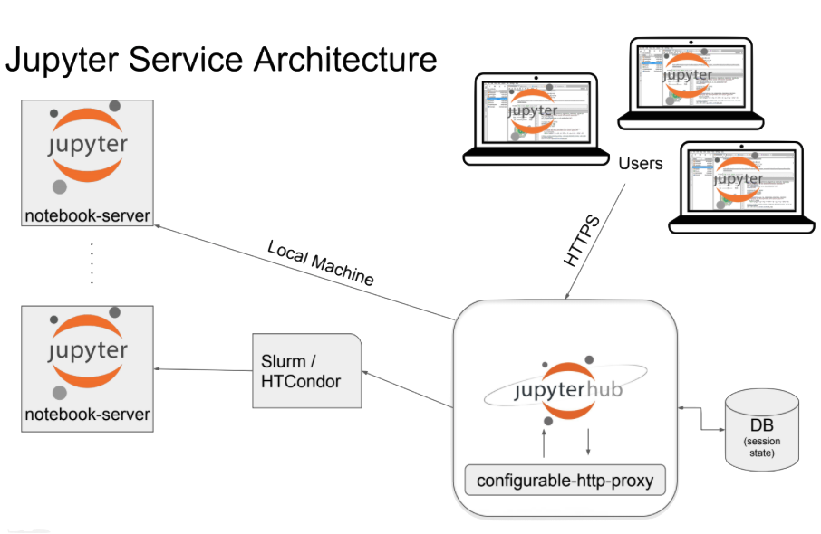
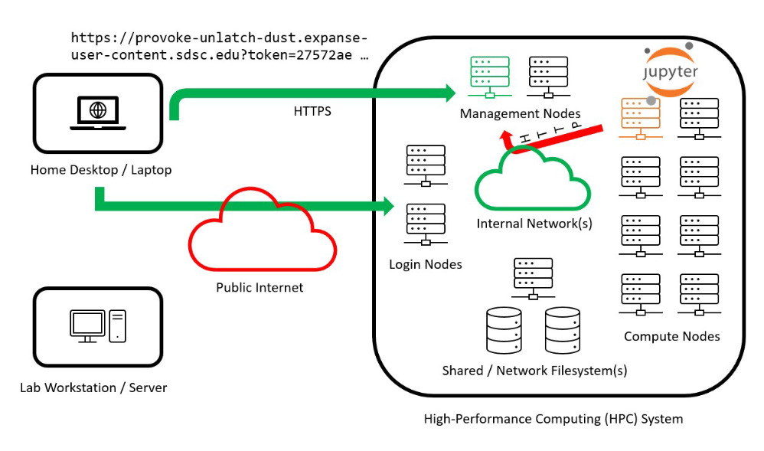
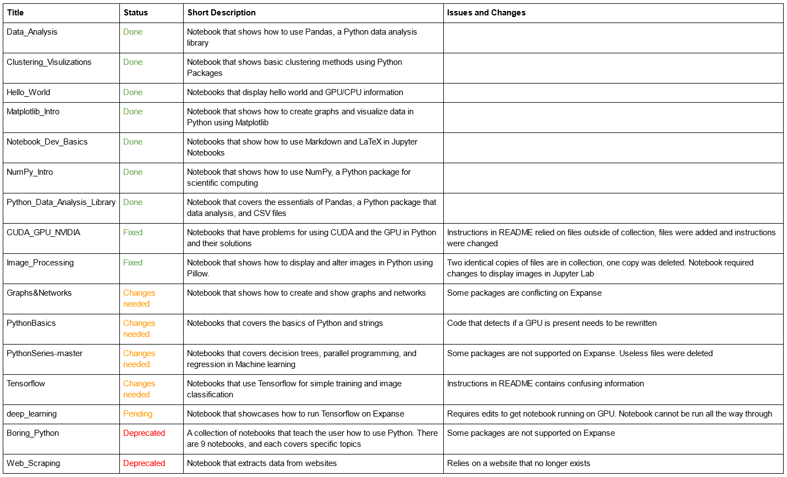
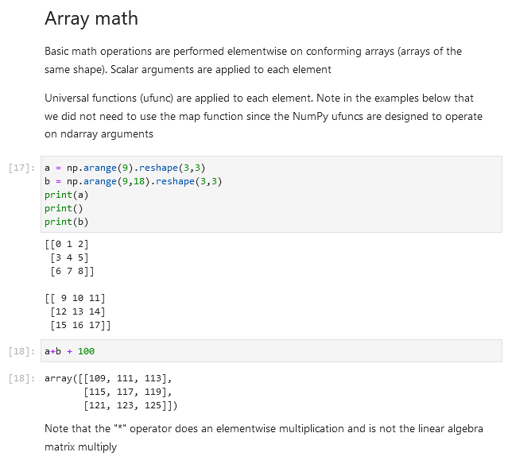
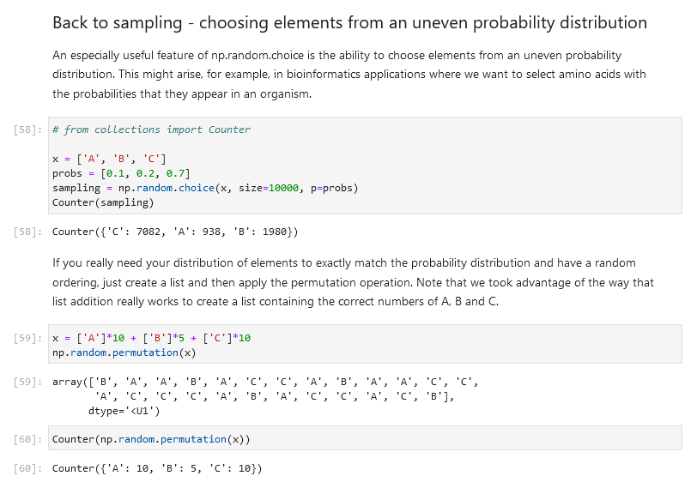
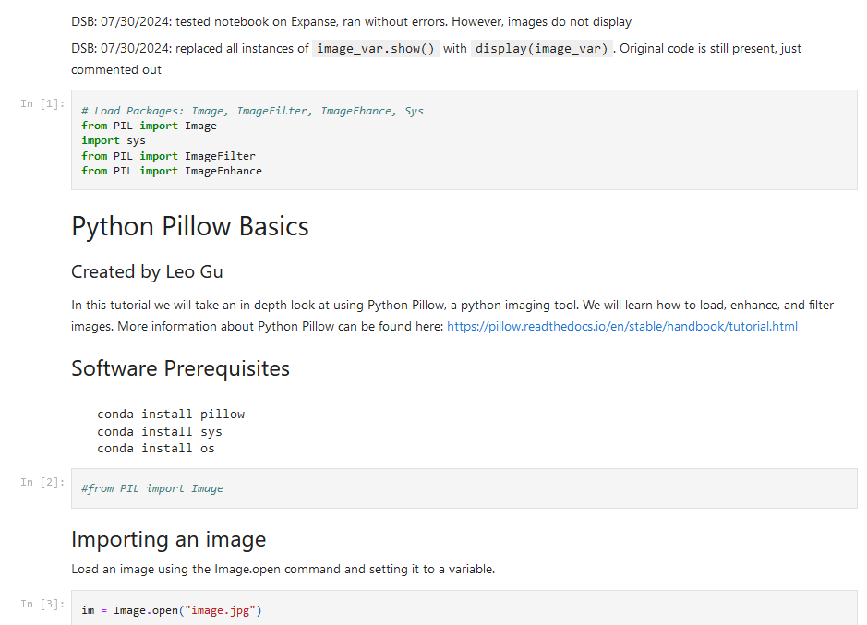
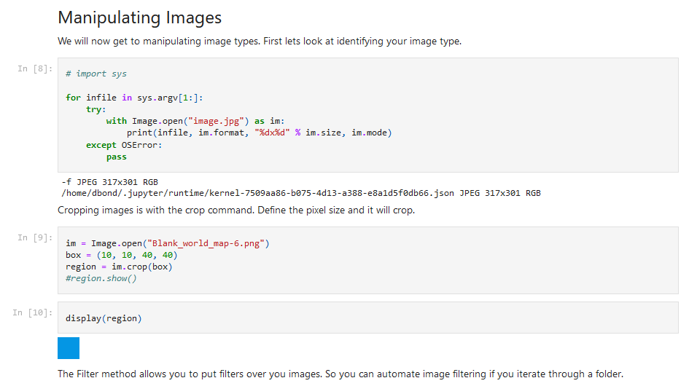
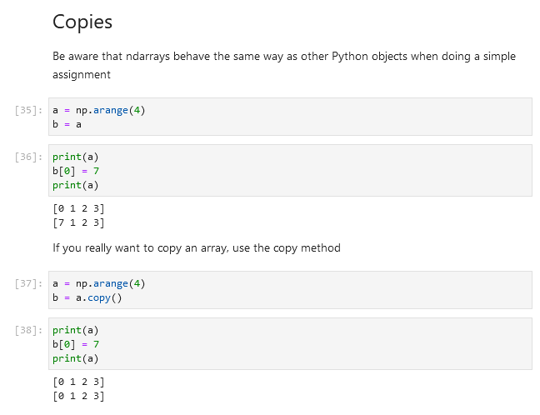
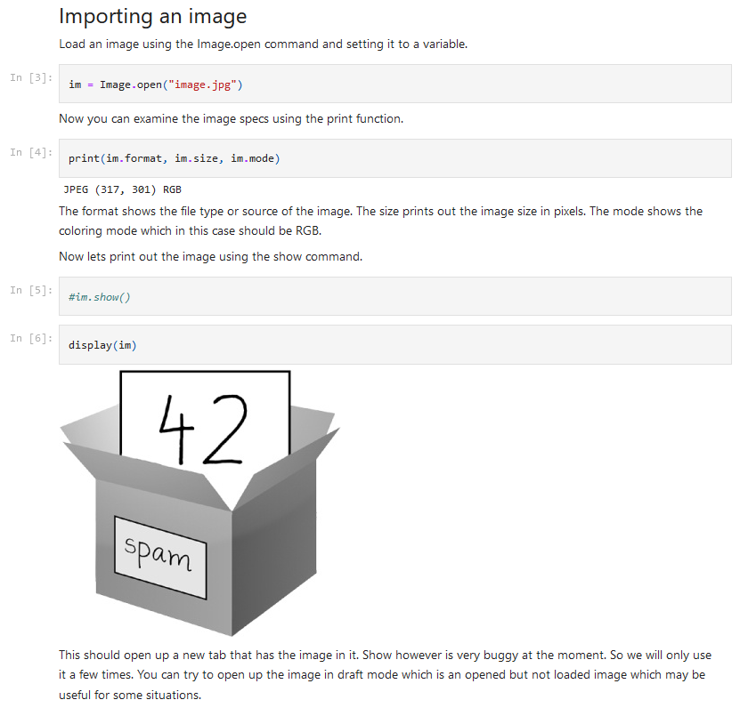
Development & Testing of Notebooks Running
on the Expanse Supercomputer
David Bond
Mentored by Mary Thomas
Abstract
The goal of this project is to ensure that the example Jupyter Notebooks on the Expanse supercomputer run properly. Expanse is complex and constantly evolving, so the programs made for it have to be maintained over time. To ensure the notebooks run properly on Expanse, every notebook has to be individually tested. Any notebook that no longer runs properly has to be altered. These notebooks are used by users of Expanse to ensure everything is running properly or to learn about new concepts. As a result of the project, we now know what notebooks run, what notebooks requires changes, and what notebooks should be deprecated.
Research & Development Process
In order to test the notebooks, I had to learn how to run and edit them securely. I began by learning how to programs on Expanse. This required me to learn how to create batch jobs. I then learned how to run notebooks on Expanse securely using Galyleo and Jupyter Lab. I had to create a GitHub repository to back up my progress while keeping my changes independent of the production notebooks. Everything was set up to test the notebooks. First, I picked a notebook. It was run, and I took notes. If the notebook could not be run, I attempted to make changes to fix the issues. This was repeated until all the notebooks were tested.
Galyleo Architecture
Jupyter starts up a server, which is the development environment that lets users run notebooks, a program that combines code, output, and documentation into one file. The server can optionally use a proxy to make connecting to the server more secure. Users can then use a standard web browser to connect to the server.
Jupyter Lab is, by default, not secure, because it uses HTTP instead of HTTPS. Galyleo is used to fix that vulnerability. A user first logs into a Login Node and run the Galyleo command. Galyleo starts Jupyter Lab on a compute node. Then, inside of the Expanse's internal network, a reverse proxy service is started in a management node. Then, users can connect to the management node using a link that is sent to them through the Login Node, which uses HTTPS. That link allows a user to connect to Jupyter Lab.
Technologies Used & Learned
Code Development
  Python
  GitHub Repositories
  Conda Environments
  Singularity Containers
Using Supercomputer
  SSH
  Batch Scripting
  CPU, GPU
  Galyleo
Jupyter Services
  Jupyter Notebooks
  Using Kernels (Python, Bash)
  Jupyter Lab
Table of Notebooks Tested
NumPy_Intro
Image_Processing
The NumPy_Intro notebook teaches the user how NumPy works, a Python package for scientific computing. The notebook runs perfectly fine on Expanse, so no changes were needed
The Image_Processing notebook showcases Pillow, a Python package for displaying and manipulating files. It did not display any images inside of Jupyter Lab. I had to alter the code to fix the issue.
Conclusion
Over the course of my internship as SDSC, I had to learn more about High Performance Computing and editing Jupyter Notebooks securely. I had to overcome many unexpected challenges, like learning how to use the batch queue, using Conda environments, and figuring out how Galyleo. In the future, the issues that I found and fixes I made will be reviewed others, who will implement the finished notebooks into Expanse. The main issue with maintaining the notebooks in the future will be making sure they work with the packages installed on Expanse, which are constantly updated.
Ange Mason
Marty Kandes
References
Galyleo Architecture: https://education.sdsc.edu/training/interactive/?id=202112_ExpanseWebinar-M.Kandes
Jupyter Architecture: https://docs.google.com/presentation/d/15MXC8HcqEhfCMeLRkLoGOrtn81R0ifg_/edit?usp=sharing&ouid=105889292217036541066&rtpof=true&sd=true
Acknowledgments

